Slide 1


Doctor Bot
AI-Powered Skin
Disease Diagnosis System.

Slide 2
PROJECT SUPERVISORS:
Prof. Dr. Hanaa Bayoumi
Eng. Doaa Mahmoud

Slide 3
PROJECT MEMBERS
Ahmed Atef Ahmed Abdeen
2101833
Mohamed Osama Mohamed 2102030
Moaz Ahmed Sayed
2102097
Abdelrhman Beshary Hamada 2101963
Mohamed Ramadan Fouad 2102038
Mohamed Mansour Abdelwahab 2102055
Mohamed Hussein Abdallah
2102033

Slide 4
AGENDA
INTRODUCTION
Mobile App
Background
TOOLS
Related Work
Conclusion
Implementation
Future work
Implementation for text
Implementation for Image

Slide 5
INTRODUCTION

Slide 6
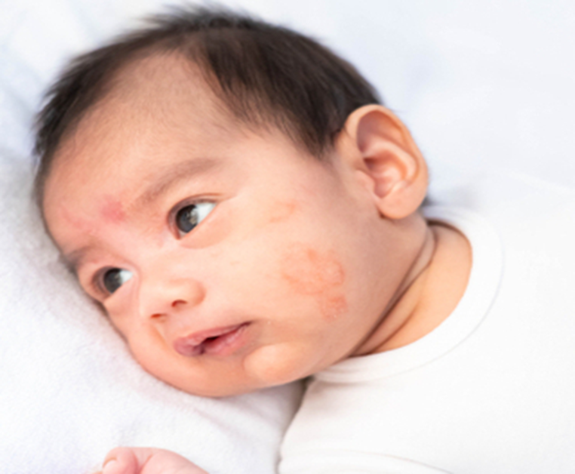
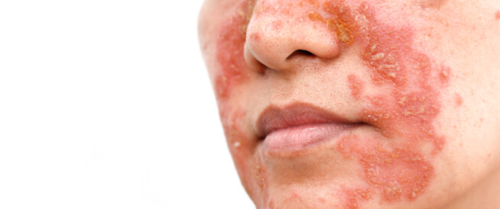
INTRODUCTION
Skin is one in every of the most important and quickest developing tissues of the human body, Which makes it susceptible to more than 3000 diseases. A cosmetically look spoiler disease will have a big effect and might reason extensive ache and everlasting injury. Also, The current system is doctor-based, which is a very slow and expensive process. It is not available to many, especially in rural areas.
Doctor Bot is an efficient AI system that increases access to healthcare, identifies diseases early, Even if the diagnosis is preliminary, and provides a cost-effective solution.

Slide 7
Background

Slide 8
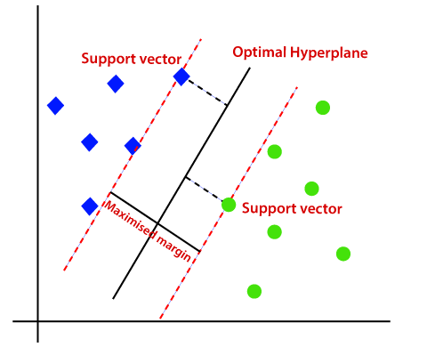
Background
Support Vector Machine (SVM)
is a type of supervised machine learning model used for classification and regression tasks we use SVM model because there is non-linearity relationship in data image SVM can actually deal with that with using kernel that can deal with it that if the face wearing mask or not and SVM so good for images that has pixel value.

Slide 9
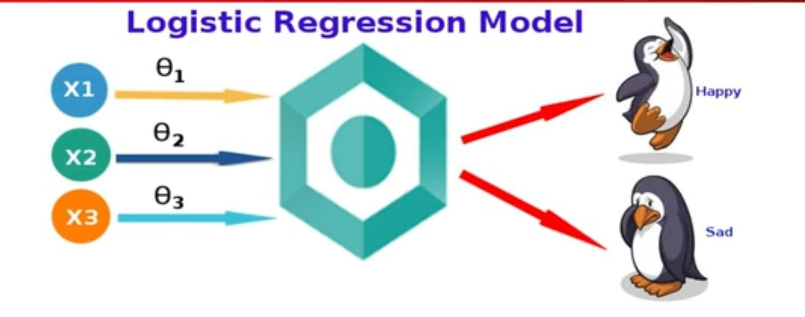
Background
Logistic Regression
is a classification algorithm based on probability statistics and the linear regression model. It is used to determine the probability that an output belongs to one of two or more categories, based on a set of input features.
In the provided code, Logistic Regression is used to classify text (after being numerically represented using TF-IDF) into categories representing diseases.

Slide 10
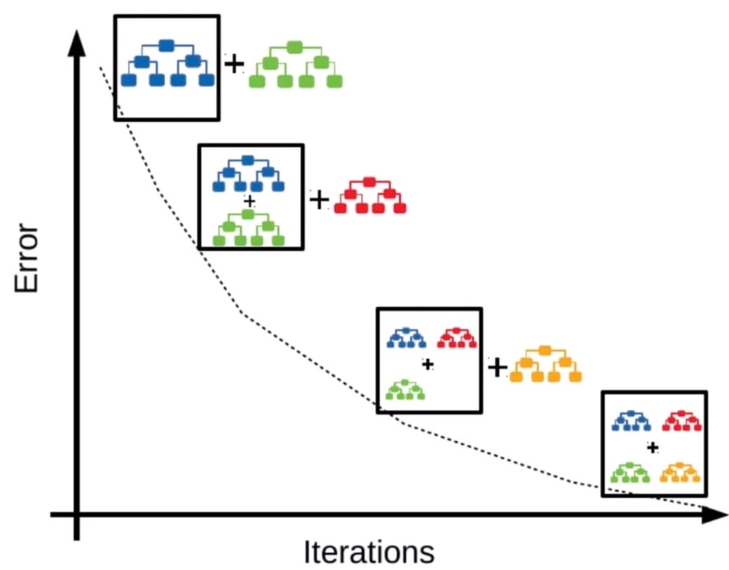
Background
XGBoost (Extreme Gradient Boosting)
is a powerful, scalable machine learning algorithm designed for supervised learning tasks, such as classification and regression. It builds an ensemble of weak prediction models—typically decision trees—sequentially, where each new model corrects errors made by the previous ones. By combining the principles of gradient boosting and advanced optimization techniques, XGBoost achieves high accuracy while minimizing overfitting.

Slide 11
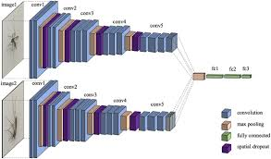
Background
VGG16
is a deep learning model introduced by the Visual Geometry Group (VGG) from the University of Oxford. It is a convolutional neural network (CNN) that has achieved great success in image recognition tasks. The "16" in VGG16 refers to the 16 weight layers (13 convolutional layers and 3 fully connected layers). VGG16 is pretrained on the ImageNet dataset, which includes millions of labeled images across thousands of categories.

Slide 12
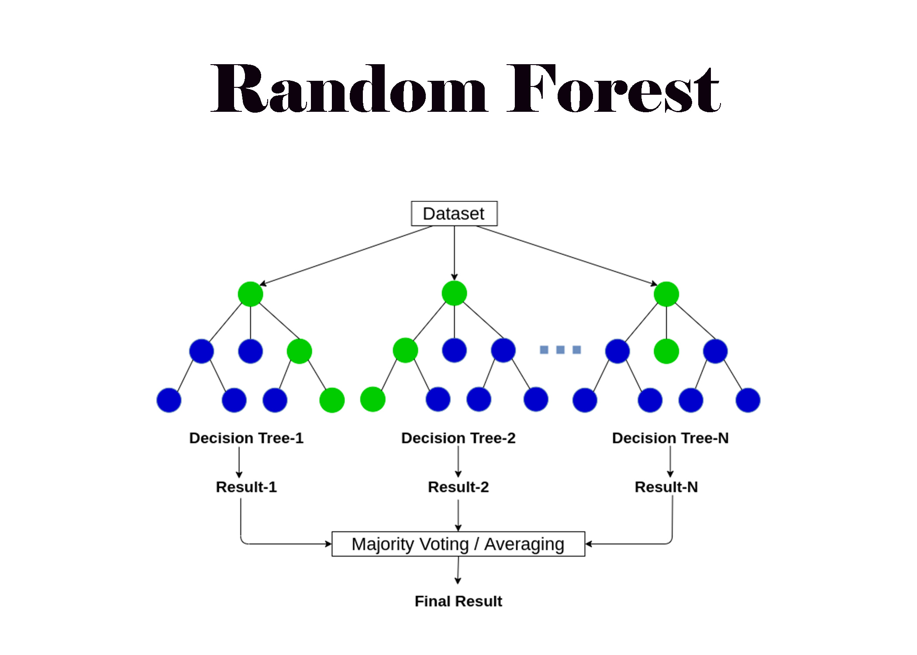
Background
Random Forest
Random Forest is an ensemble learning method that builds multiple decision trees and merges their results to improve classification accuracy. It is robust to overfitting and performs well on both balanced and imbalanced datasets. It works by averaging predictions of multiple trees to reduce variance and improve generalization.

Slide 13
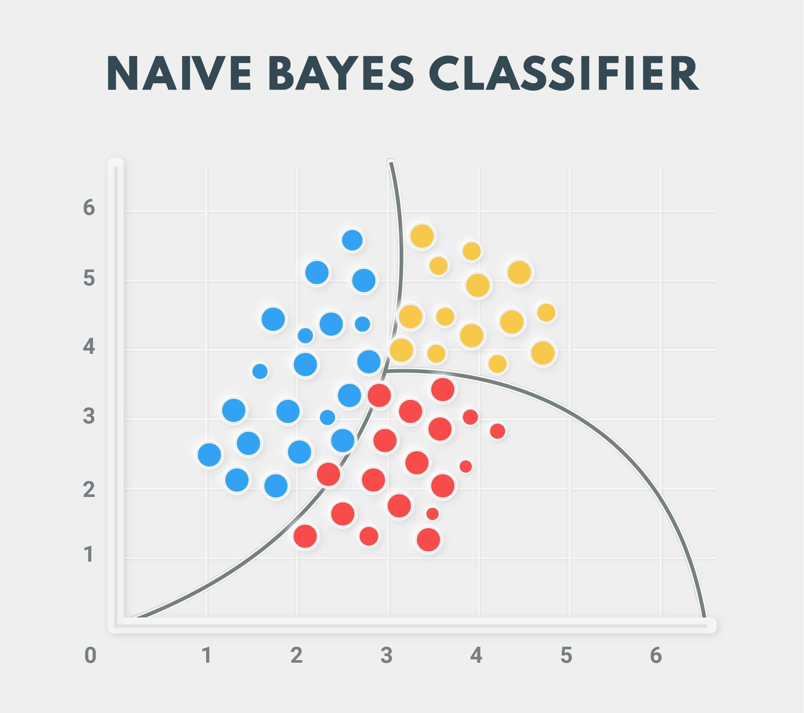
Background
Naive Bayes
Naive Bayes is a probabilistic classification algorithm based on Bayes’ Theorem. It assumes independence between features, making it very fast and efficient for high-dimensional data like text. Despite its simplicity, it performs well in many real-world applications such as spam detection and symptom-based disease classification.

Slide 14
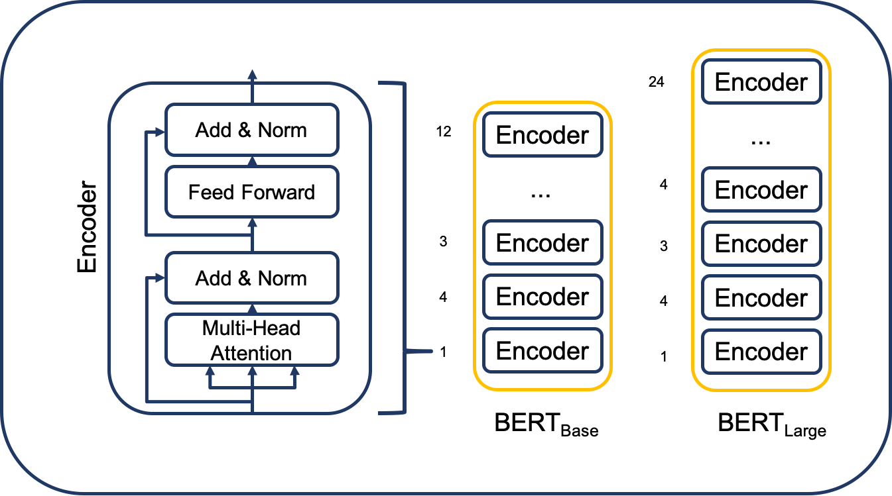
Background
BERT
BERT (Bidirectional Encoder Representations from Transformers) is a deep learning model developed by Google for understanding the context of words in a sentence. Unlike traditional models, BERT reads text bidirectionally, capturing meaning based on both previous and next words. It's widely used in NLP tasks like question answering, classification, and chatbot applications.

Slide 15
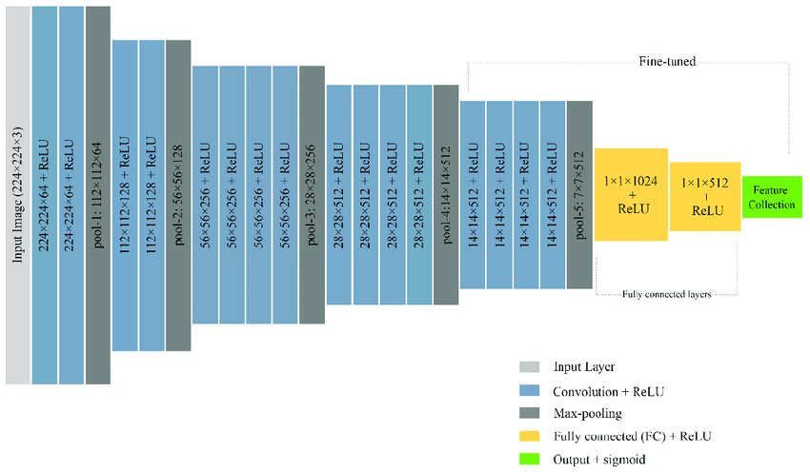
Background
VGG19
Pretrained on the ImageNet dataset, VGG19 is widely used for feature extraction in computer vision tasks. It excels at capturing visual patterns such as edges, textures, and shapes from input images. Its depth allows it to learn complex hierarchical features, making it suitable for medical image classification tasks like skin disease detection.

Slide 16
Related Work

Slide 17
Related Work
Paper | objective | Dataset | Models & Accuracy | Limitation
https://www.kaggle.com/datasets/rafsunahmad/skin-disease-text-classification (04 Jan 2024) | The goal is to develop a language model for predicting diseases from user-reported symptoms. | Skin Disease Text Classification (text data) 34.81 kB | SVM Accuracy 75% | Limited Data Size. Ambiguity in Symptoms
https://www.kaggle.com/datasets/niyarrbarman/symptom2disease (04 Apr 2023) | The task is to develop a language model to accurately predict the disease given a short description of the symptoms faced by the user. | Symptom2Disease (text data) 229.85 kB | KNN Accuracy 95% | Class unbalanced . 3 classes only.
Knowledge Graph and Deep Learning-based Text-to-GraphQL Model for Intelligent Medical Consultation Chatbot (06 July 2022) | Text-to-GraphQL (Text2GraphQL) is a task that converts the user's questions into Graph QL (Query Language) when a graph database is given. | AI medical chatbot (text data) 267.26 MB | RNN Accuracy 80% | Class unbalanced. 3 classes only. Lack of graph databases for execution support.

Slide 18
Related Work
Paper | objective | Dataset | Models & Accuracy | Limitation
Skin Disease Recognition by VGG-16 Model (23 July 2023) | It highlights the importance of early detection of skin diseases through dermoscopic analysis and clinical skin screening. | DermNet (Image data) (23 different classes) (image data) Size: The total number of images are around 19,500 | CNN & VGG16 Accuracy 83.99% | Class unbalanced. Limited Learning Capability. Dependency on Dataset Size
Multiclass skin cancer classification using EfficientNets –preventing skin cancer (6 December 2022) | The aim of this article is to develop an AI model for multiclass skin cancer classification using convolutional neural networks (CNNs). | HAM 10000 Dataset (image data) Containing over 10,000 labeled images of different | CNN & EfficientNet Accuracy 87.91% | Data unbalanced. Generalizability.
Finally, we use Updated Skin Disease Text Classification
(Merge more than one dataset together( on Text
DermNet on Photos and RealTime Images

Slide 19
Implementation
For Text and Image

Slide 20
Image Dataset
Proposal Method
Text Dataset
Data Preprocessing
Data Preprocessing
Sampling The Data
Sampling The Data
Training Data (80%)
Testing Data (20%)
T
Training Data (80%)
Testing Data (20%)
T
App
Input Text OR Image
Machine Learning Techniques
Machine Learning Techniques
R
T
Traditional
Deep Learning
T
Traditional
Deep Learning
Check Confidence
Soft Voting Ensemble Classifier (Highest Average Probability )
Final Prediction Results
R
R
Final Prediction Results
Return Result on App
Result Analysis And Performance Evaluation
Result Analysis And Performance Evaluation

Slide 21
Implementation
For Text

Slide 22
Data Description
Dataset Selection
The dataset is named 'Skin Disease Text' and has a size of 2.26 MB. It contains (70 (Old Data) + 1330 (New Data) = 1400 data points) across two columns: 'label' and 'text'. The dataset includes 7 different diseases, each with 200 symptom descriptions:
Eczema
Psoriasis
Scabies
Ringworm
Acne
Impetigo
Contact Dermatitis
Data Reference
https://github.com/1moh1/Skin_Disease

Slide 23
Techniques
Synonym Replacement
Word Order Shuffle
Paraphrasing
Medical Contextual Embedding Augmentation Using RoBERTa
Before
After

Slide 24
Data Augmentation
Before | After
200 symptoms for each disease (7 disease) | 2000 symptoms for each disease (7 disease)
total symptoms ( 1400 ) | total symptoms ( 14000 )

Slide 25
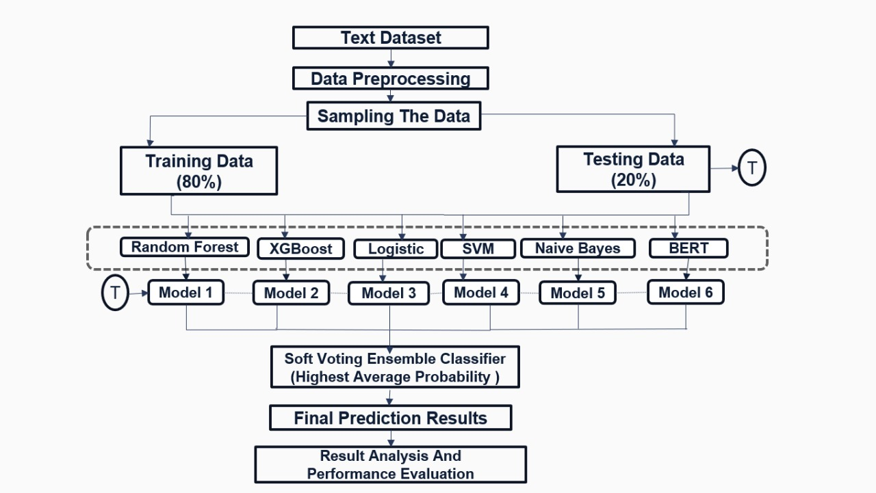
Proposed text model

Slide 26
Modifications that led to increased accuracy
Improve data processing (Preprocessing)
Use powerful models and improve their tuning.
Use Voting Classifier
01
02
03
Compared to reference, the following has been improved
Use new model Deep learning (BERT)
04

Slide 27
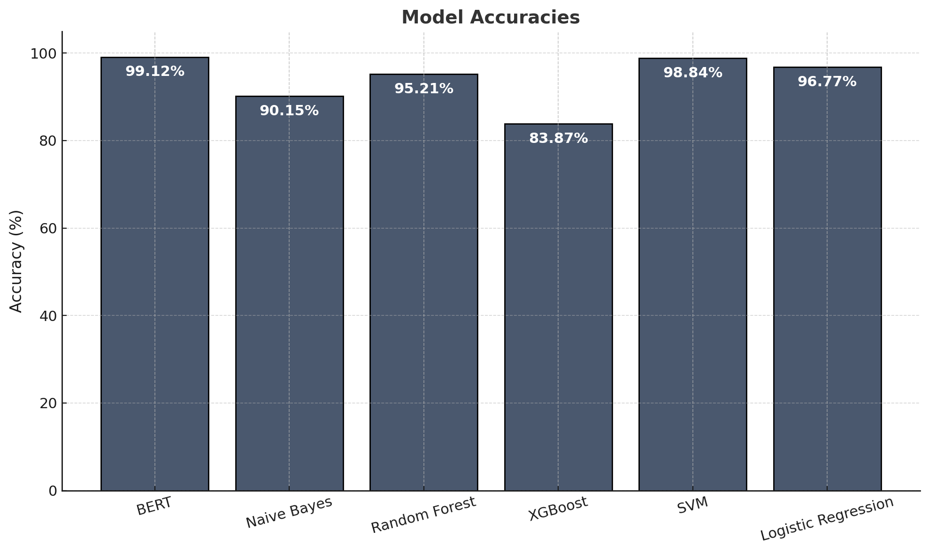
Model Evaluation
Machine learning model accuracies:
Logistic Regression: 96.77%
SVM: 98.84%
XGBoost: 83.87%
Voting Classifier: 97.85%
Naive Bayes: 90.15%
Random Forest: 95.21%
Deep learning
model accuracies:
. BERT: 99.12%

Slide 28
Implementation
For Image

Slide 29
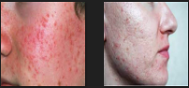
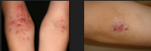
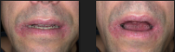
Data Description
Dataset Selection
Acne
The dataset used is called DermNet and it has a total of 3600 images divided to 3000 training and 600 testing, the type of images are JPG, JPEG and PNG and the size of data is approximately 2.8 GBs and split into 7 different catagories which are Acne, Scabies, Impetigo, Tinea, Dermatitis, Eczema and Psoriasis. The resolution of this data is around 1024x1024.
Eczema
Tinea Ringworm
Data Reference
:https://www.kaggle.com/datasets/shubhamgoel27/dermnet

Slide 30
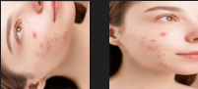
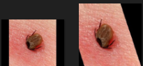
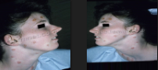
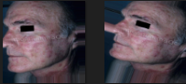
Data Augmentation
Image Rotation
Image Shearing
Rotation
Shifting
Shearing
Zooming
Filling
Flipping
Image Flipping
Image Filling

Slide 31
Results of Augmentation
Disease | Before | After
Acne | 2328 | 3600
Scabies | 2052 | 3600
Dermatitis | 1952 | 3600
Impetigo | 1924 | 3600
Psoriasis | 1757 | 3600
Tinea (Ringworm) | 1625 | 3600
Eczema | 1544 | 3600

Slide 32
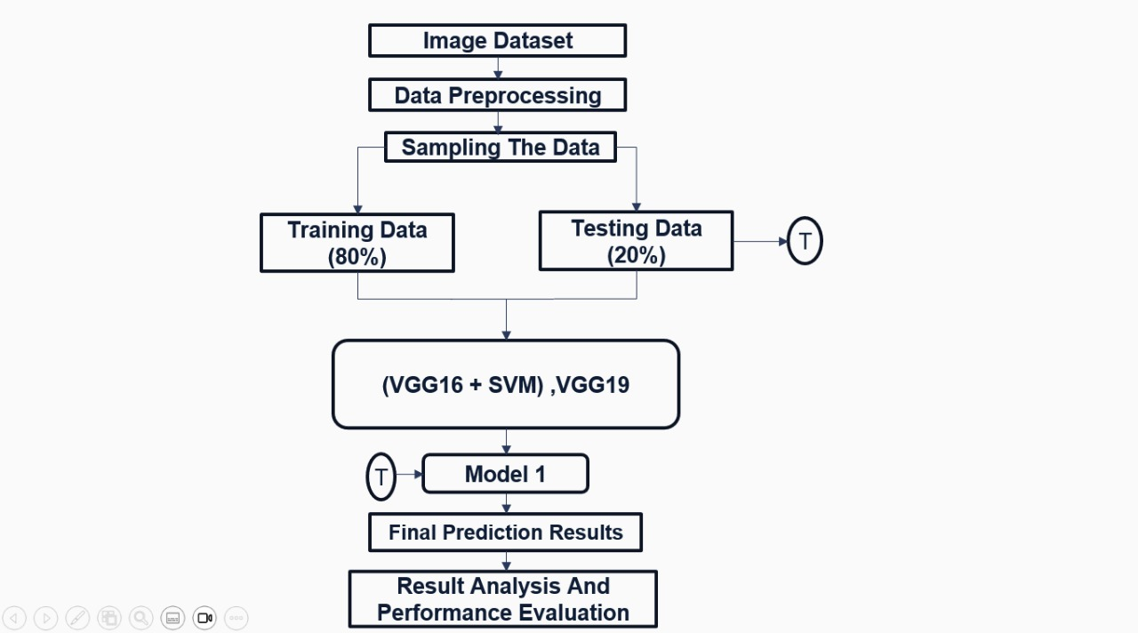
Proposed image model

Slide 33
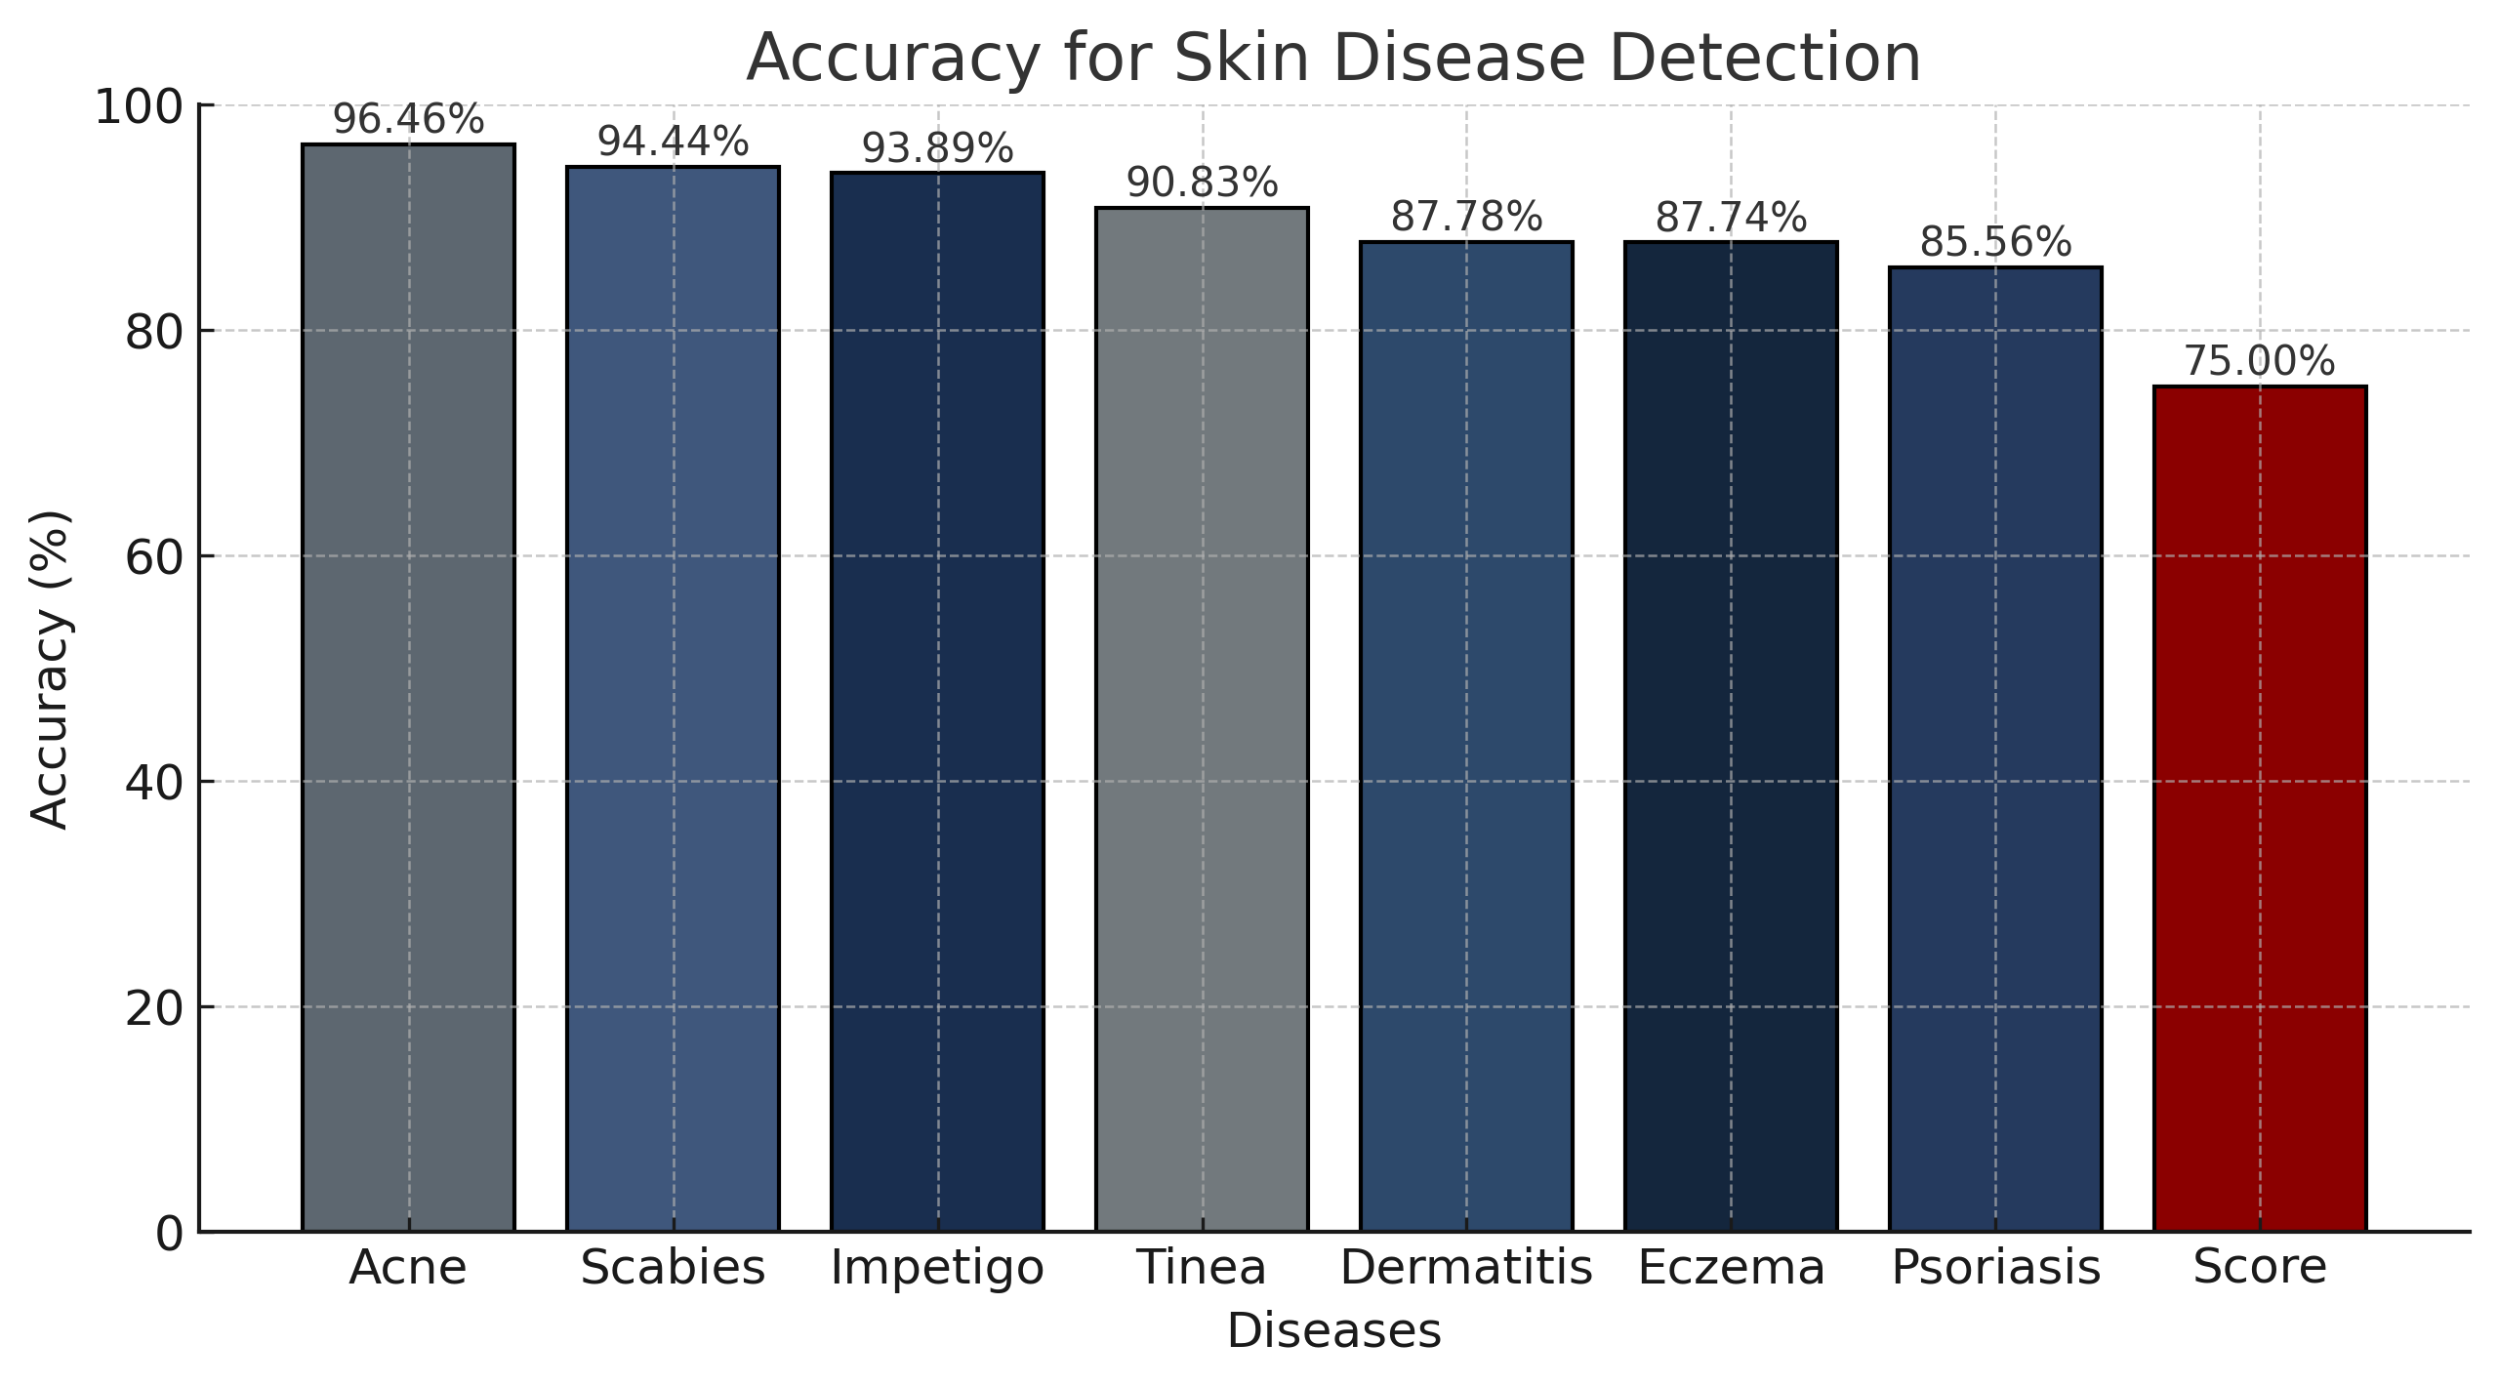
Model Evaluation (SVM + VGG16)
Diseases accuracies:
96.46% Acne
94.44% Scabies
93.89% Impetigo
90.83% Tinea
87.78% Dermatitis
87.74% Eczema
85.56% Psoriasis
Compared to The Reference which uses CNN + VGG16 Our model uses SVM + VGG16
And it gave us 75% Total accuracy with a simpler model (SVM)

Slide 34
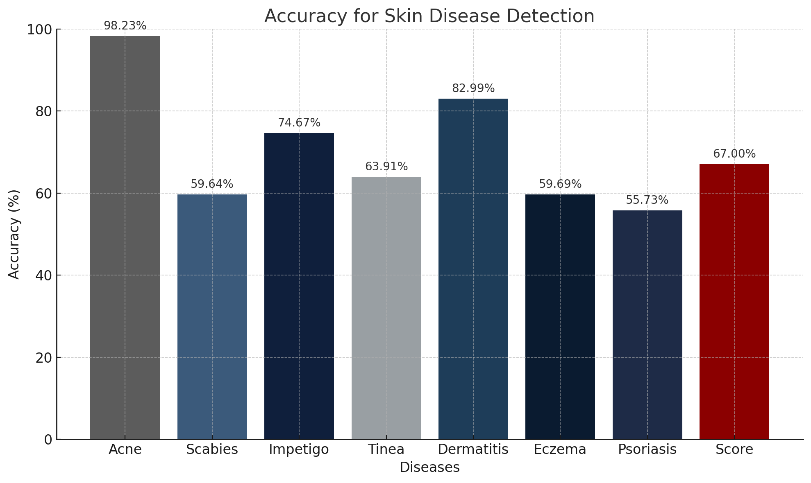
Model Evaluation (VGG19)
Diseases accuracies:
98.23% Acne
59.64% Scabies
74.67% Impetigo
63.91% Tinea
82.99% Dermatitis
59.69% Eczema
55.73% Psoriasis
Compared to the first phase where we used VGG16 + SVM, we used VGG19 full model, And it gave us a total accuracy of 67% using deep learning model (VGG19)

Slide 35
Mobile App

Slide 36
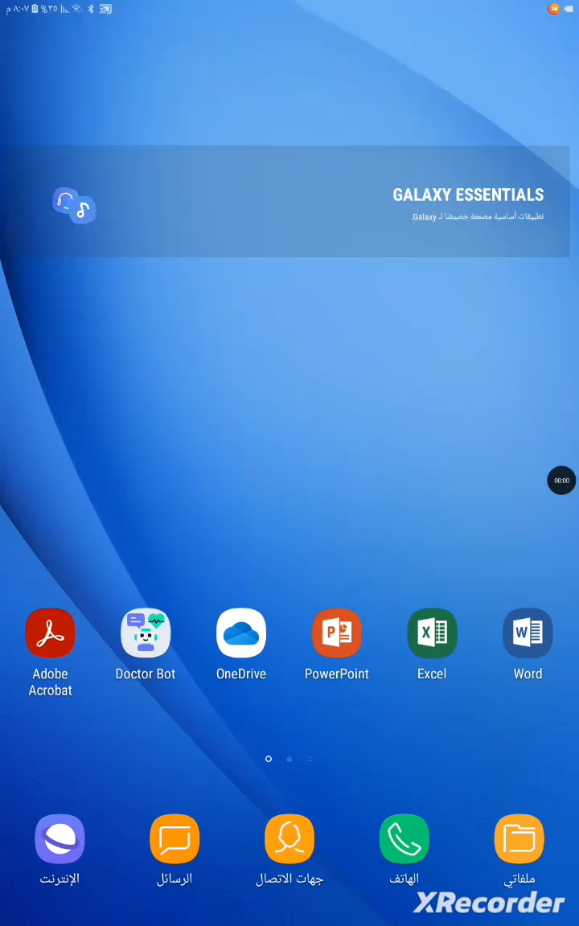
How to use the app

Slide 37
TOOLS

Slide 38







Flutter: For designing the app’s interface and how it works for users.
Visual Studio Code: Used for integration and development of various parts of the application.
Python: For running the AI models and analyzing data.
Flask: To connect the app interface with the AI models.
Android Studio: Used for simulating and testing the application on virtual Android devices
Anaconda: For managing programs and libraries needed for AI development.
Google Colab: For building, training, and evaluating AI models collaboratively using Python in the cloud.

Slide 39
Conclusion

Slide 40
Conclusion
Doctor Bot: AI-Powered Healthcare Revolution
The Doctor Bot application harnesses the power of artificial intelligence to transform healthcare systems. By integrating both image and text-based models within a unified app framework, it ensures seamless interaction between different AI components, enhancing efficiency and accuracy in disease diagnosis.
AI Model Integration
Image Models: SVM, VGG16, VGG19 is used for advanced image processing and accurate skin disease detection.
Text Models: Logistic Regression, SVM, XGBoost, Random Forest, Naive Bayes, and BERT are employed for effective text classification and medical data analysis.
The app framework: effectively merges these models for optimized data processing and an improved user experience.

Slide 41
Future work

Slide 42
Future work
Expand and Diversify Datasets Collect more medical images and texts from trusted sources to improve accuracy and reduce bias.
Support More Diseases Go beyond skin conditions to include respiratory, digestive, eye-related diseases, and common infections.
Voice Input Allow users to speak their symptoms, making it easier for people with disabilities or low literacy.
Multilingual Support Add more languages to serve a wider range of users and ensure accurate medical translations.

Slide 43

THANK YOU
Any questions?

